Slide 1



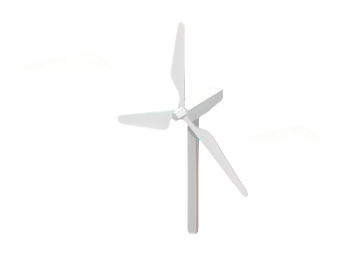
Weekly report: Storage System
5th week – 6th Presentation
Date: 28/10/2025
Supervisor: Dr. Laurence Alhrshy
Group members: Mohamed Ahmed
28/10/2025
Mohamed Ahmed
Storage System Team/ Optimus Syria
Notes:
`

Slide 2

Battery Technologies for Large-Scale Energy Storage
Content
Quick review
Introduction
Applications for Wind Energy Storage in Syria
Lithium-Ion Battery
Lithium-Ion Technical Performance
References
14/10/2025
Mohamed Ahmed
Storage System Team/ Optimus Syria

Slide 3
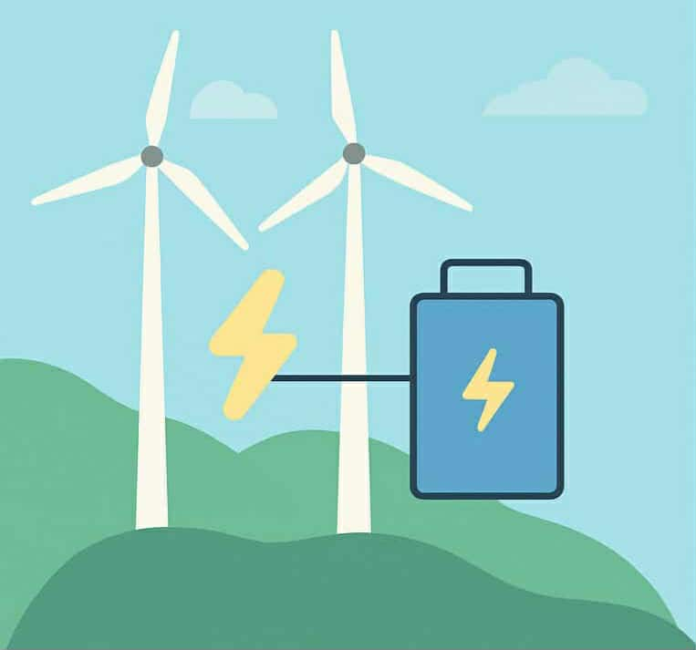
Quick review
Why do we need a storage system?????
We need an energy storage system in wind turbines to:
ensure a stable power supply.
balance energy generation and demand.
improve grid reliability.
maximize wind energy utilization.
28/10/2025
Mohamed Ahmed
Storage System Team/ Optimus Syria

Slide 4
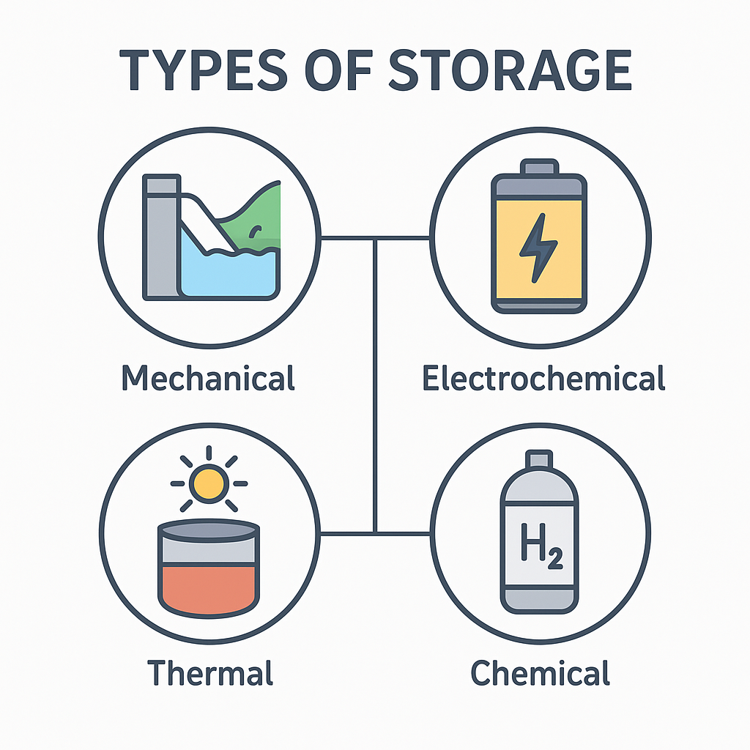
Quick review
Types of storage
Mechanical Storage System.
Electrochemical Storage System.
Thermal Storage System.
Chemical Storage System.
28/10/2025
Mohamed Ahmed
Storage System Team/ Optimus Syria

Slide 5
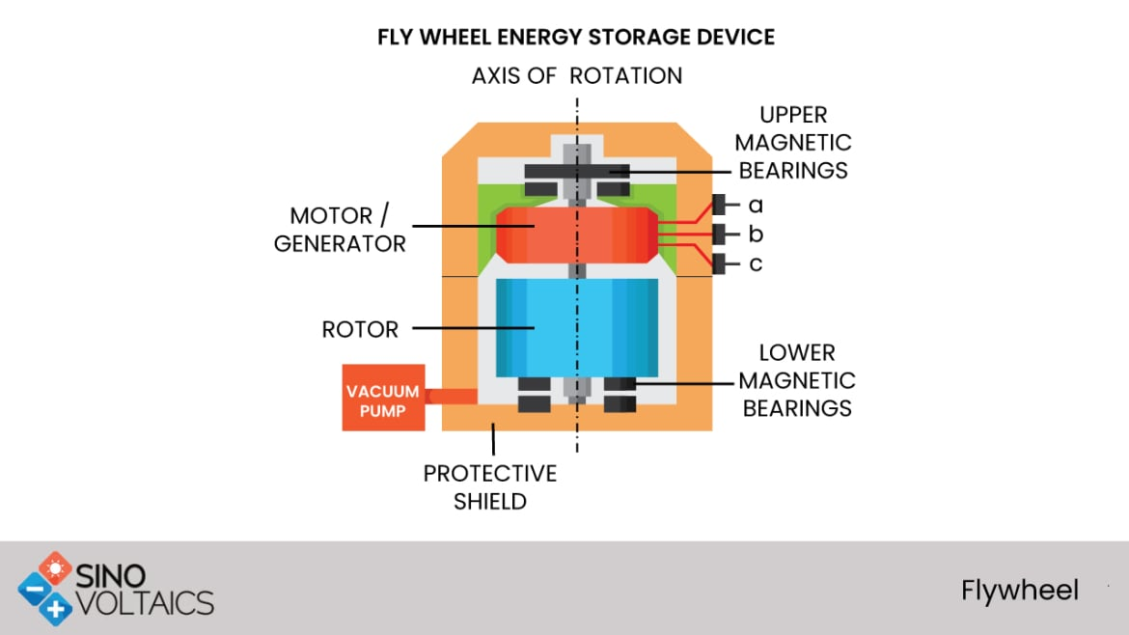
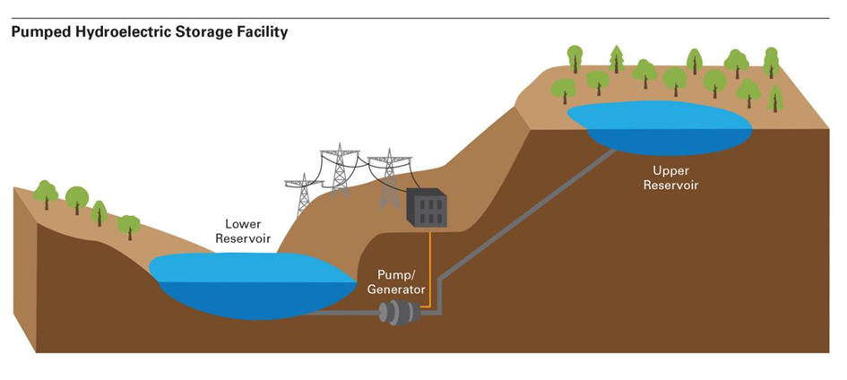
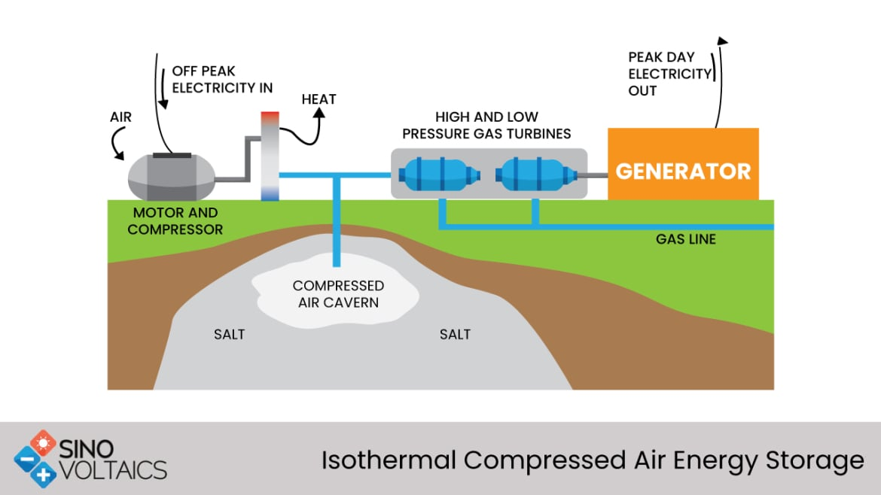
Types of Mechanical Storage System
Flywheel Energy Storage (FES)
Pumped Hydroelectric Storage (PHS)
28/10/2025
Mohamed Ahmed
Storage System Team/ Optimus Syria

Slide 6
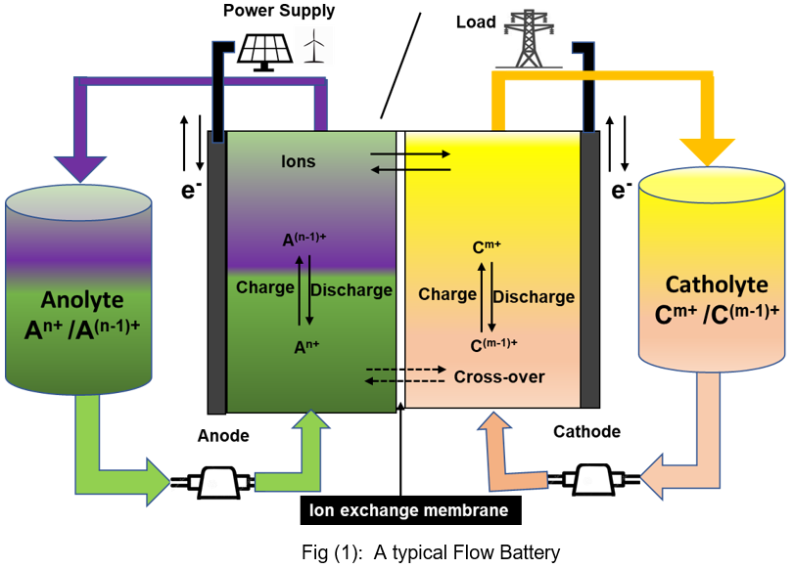
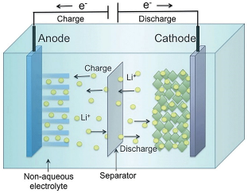
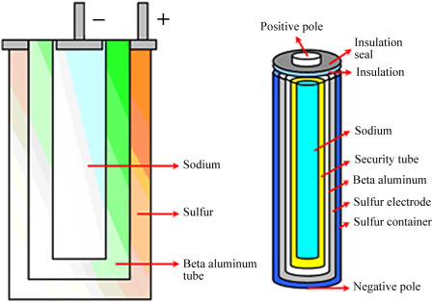
Types of Electrochemical Storage System
Flow Batteries
Lithium-Ion Batteries
Sodium-Sulfur Batteries
28/10/2025
Mohamed Ahmed
Storage System Team/ Optimus Syria

Slide 7
Introduction
Today I will present our topic about energy storage systems, focusing on Lithium-ion batteries as a key solution for integrating renewable energy especially wind power into the grid. As we know, wind energy generation is variable and depends on weather conditions. Therefore, energy storage plays a vital role in stabilizing power supply, improving reliability, and reducing curtailment losses.
In this presentation, I will explain the lifecycle, reliability, capacity, cost, payback, and safety factors of Lithium-ion batteries and why they are currently the most suitable technology for wind energy storage systems.
28/10/2025
Mohamed Ahmed
Storage System Team/ Optimus Syria

Slide 8
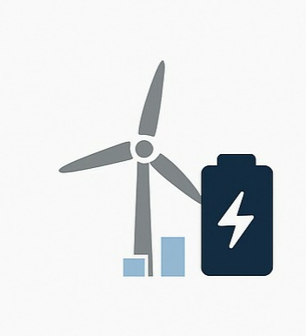
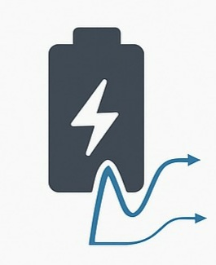
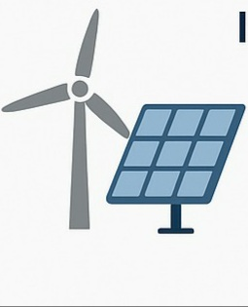
Applications for Wind Energy Storage in Syria
• Peak Shaving and Load Balancing:
Wind energy generation is intermittent, with higher output during nighttime and monsoons. Li-ion batteries can store excess energy and release it during high-demand periods.
• Frequency Regulation:
Syria's grid stability is a concern. Li-ion batteries can provide near-instantaneous power to stabilize the grid frequency.
• Integration with Wind-Solar Hybrid Projects.
28/10/2025
Mohamed Ahmed
Storage System Team/ Optimus Syria

Slide 9
Lithium-Ion Battery
Battery Type - Why Lithium-Ion is the Preferred Choice?
High Energy Density: Can store large amounts of energy in a compact size — ideal for space-limited installations.
High Efficiency: Round-trip efficiency of 90–95%, minimizing energy loss during charge/discharge.
Fast Response Time: Provides instantaneous power — perfect for grid stabilization and frequency regulation.
Long Cycle Life: Typically 2,000–5,000 charge cycles, ensuring long-term performance and cost-effectiveness.
Low Self-Discharge: Maintains stored energy effectively during idle periods.
28/10/2025
Mohamed Ahmed
Storage System Team/ Optimus Syria

Slide 10
Lithium-Ion Technical Performance
Lifecycle
Average lifetime: 10–15 years, depending on usage and temperature.
2,000–5,000 full cycles before noticeable degradation.
Longer life with advanced chemistries such as LFP (Lithium Iron Phosphate).
Reliability
Proven and commercially mature technology used worldwide.
High round-trip efficiency (90–95%) ensures consistent performance.
Integrated Battery Management System (BMS) prevents overcharging and overheating.
Capacity
Defined as Energy (kWh) = Power (kW) × Time (h).
Typically designed for 1–4 hours of discharge duration in wind applications.
28/10/2025
Mohamed Ahmed
Storage System Team/ Optimus Syria

Slide 11
Lithium-Ion Technical Performance
Cost
Capital cost: around 130–150 USD/kWh (continuously decreasing).
Operating cost: low, due to minimal maintenance needs.
Levelized Cost of Storage (LCOS): competitive for grid-scale wind energy systems.
Payback Period
Typically 6–8 years, depending on local electricity prices and curtailment reduction.
Fast return supported by decreasing battery prices and policy incentives.
Safety
Main risk: thermal runaway in high-temperature conditions.
Mitigation: advanced cooling systems and BMS monitoring.
LFP batteries are safer — no cobalt, improved thermal and chemical stability.
Continuous improvement in fire protection and recycling processes.
28/10/2025
Mohamed Ahmed
Storage System Team/ Optimus Syria

Slide 12
References
https://www.battery.associates/post/state-of-art-of-flow-batteries-a-brief-overview
https://bslbatt.com/blogs/lithium-battery-price-2025-current-costs-trends-and-changes/
https://www.sciencedirect.com/science/article/pii/S0306261924003374
https://www.irena.org/publications/2017/Oct/Electricity-storage-and-renewables-costs-and-markets
https://www.iea.org/energy-system/electricity/grid-scale-storage
https://arxiv.org/pdf/1903.12029
https://iea.blob.core.windows.net/assets/773bd056-f289-4c63-b689-8f88fe3e82f9/KarnatakaPSTWorkshopReport.pdf
28/10/2025
Mohamed Ahmed
Storage System Team/ Optimus Syria

